Slide 1
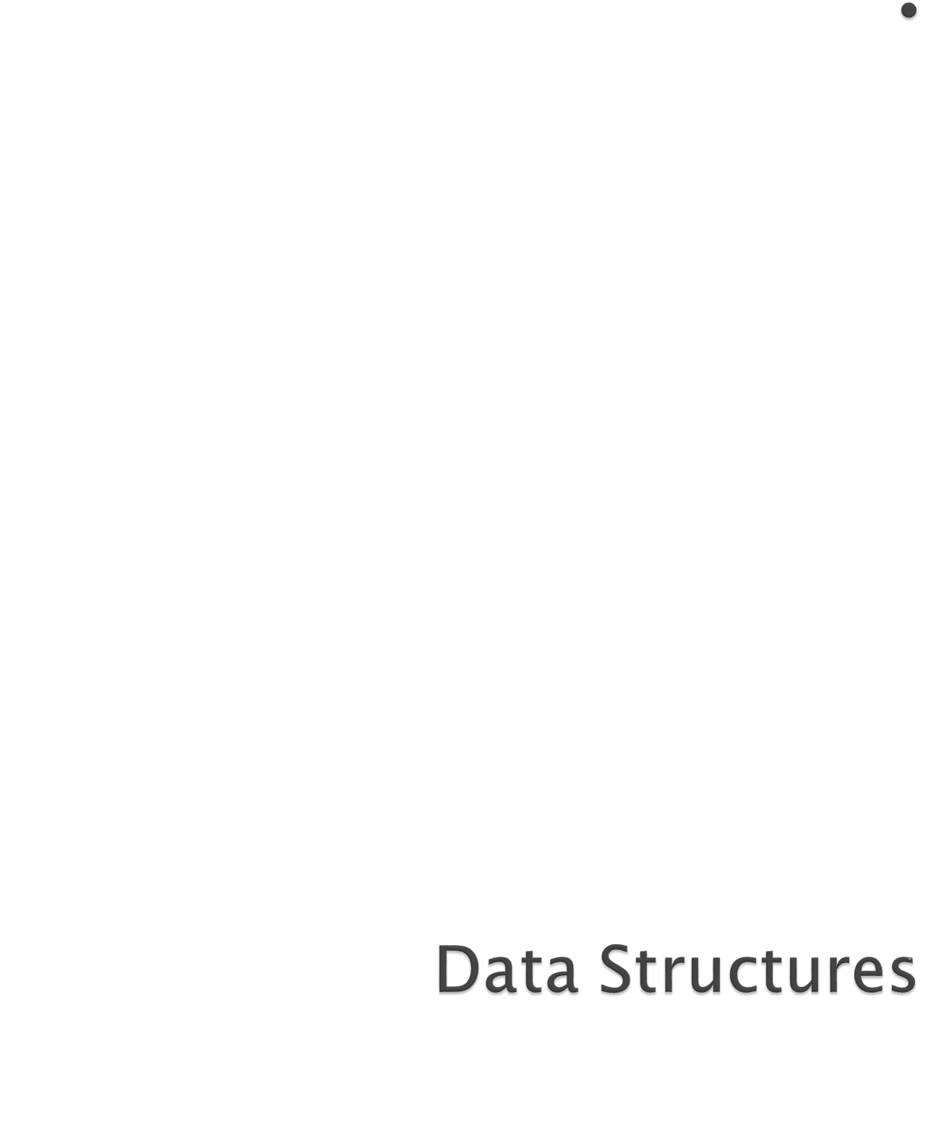
Overview.
Algorithm Analysis.

Slide 2

Be familiar with problem solving.
Be able to develop (and implement) algorithms.
Be able to trace algorithms.
Be able to select appropriate data structures and algorithms for given problems.

Slide 3

Prerequisites:
  Variables and expressions.
  Methods (functions or procedures ).
  Decision structures( like if-statements and switch-statements.
  Iteration structures (for-loops and while-loops).
  Classes and objects

Slide 4

Data
  A collection of facts from which conclusion may be drawn.
  e.g. Data: Temperature 35°C; Conclusion: It is hot.
Types of data
  Textual: For example, your name (Alya)
  Numeric: For example, your ID (090254)
  Audio: For example, your voice
  Video: For example, your voice and picture
  (...)

Slide 5

Applications/programs read data, store data temporarily, process it and finally output results.
What is data? Numbers, Characters, etc.
Data
Application/
Program
Data

Slide 6
Data is classified into data types. e.g. char, float, int, etc.
A data type is (i) a domain of allowed values and (ii) a set of operations on these values.
Compiler signals an error if wrong operation is performed on data of a certain type. For example, char x,y,z; z = x*y is not allowed.

Slide 7
Examples
Data Type | Domain | Operations
boolean | 0,1 | and, or, =, etc.
char | ASCII | =, <>, <, etc.
integer | -maxint to +maxint | +, _, =, ==, <>, <, etc.

Slide 8
Simple Data types: also known as atomic data types → have no component parts. E.g. int, char, float, etc.
21
3.14
‘a’

Slide 9

A particular way of storing and organizing data in a computer so that it can be used efficiently and effectively.
Data structure is the logical or mathematical model of a particular organization of data.
A group of data elements grouped together under one name.
  For example, an array of integers

Slide 10
Structured Data types: can be broken into component parts. E.g. an object, array, set, file, etc. Example: a student object.
Name
A | H | M | A | D
20
C | S | C
Age
Branch
A Component part

Slide 11
Types of Data Structures
Array
Linked List
Queue
Stack
Tree
There are many, but we named a few. We’ll learn these data structures in great detail!

Slide 12

Goal: to organize data
Criteria: to facilitate efficient
  storage of data
  retrieval of data
  manipulation of data
Design Issue:
  select and design appropriate data types
  (This is the main motivation to learn and understand data structures)

Slide 13
(Demonstrate using class room example!)
Navigating
  Accessing each data element exactly once so that certain items in the data may be processed
Searching
  Finding the location of the data element (key) in the structure
Insertion
  Adding a new data element to the structure

Slide 14
Deletion
  Removing a data element from the structure
Sorting
  Arrange the data elements in a logical order (ascending/descending)
Merging
  Combining data elements from two or more data structures into one

Slide 15

A finite set of instructions which accomplish a particular task
A method or process to solve a problem
Transforms input of a problem to output
Algorithm = Input + Process + Output
Algorithm development is an art – it needs practice, practice and only practice!

Slide 16

It must be correct
It must be finite (in terms of time and size)
It must terminate
It must be unambiguous
  Which step is next?
It must be space and time efficient
A program is an instance of an algorithm, written in some specific programming language

Slide 17

Problem: Find maximum of a, b, c
Algorithm
  Input = a, b, c
  Output = max
  Process
    Let max = a
    If b > max then
      max = b
    If c > max then
      max = c
    Display max
Order is very important!!!

Slide 18
Clearly identify:
    what output is required?
    what is the input?
    What steps are required to transform input into output
      The most crucial bit
      Needs problem solving skills
      A problem can be solved in many different ways
      Which solution, amongst the different possible solutions is optimal?

Slide 19

A sequence of steps to solve a problem
We need a way to express this sequence of steps
  Natural language (NL) is an obvious choice, but not a good choice. Why?
    NLs are notoriously ambiguous (unclear)
  Programming language (PL) is another choice, but again not a good choice. Why?
    Algorithm should be PL independent
  We need some balance
    We need PL independence
    We need clarity
    Pseudo-code provides the right balance

Slide 20

Pseudo-code is a short hand way of describing a computer program
Rather than using the specific syntax of a computer language, more general wording is used
It is a mixture of NL and PL expressions, in a systematic way
Using pseudo-code, it is easier for a non-programmer to understand the general workings of the program

Slide 21

Use PLs construct that are consistent with modern high level languages, e.g. C++, Java, ...
Use appropriate comments for clarity
Be simple and precise

Slide 22

Expressions
  Standard mathematical symbols are used
    Left arrow sign (←) as the assignment operator in assignment statements (equivalent to the = operator in Java)
    Equal sign (=) as the equality relation in Boolean expressions (equivalent to the "= =" relation in Java)
    For example
    Sum ← 0
    Sum ← Sum + 5
    What is the final value of sum?

Slide 23

Decision structures (if-then-else logic)
  if condition then
  true-actions
  [else
  false-actions]
  We use indentation to indicate what actions should be included in the true-actions and false-actions
  For example
    if marks > 50 then
    print “Congratulation, you are passed!”
    else
    print “Sorry, you are failed!”
  end if
  What will be the output if marks are equal to 75?

Slide 24
Loops (Repetition)
  Pre-condition loops
    While loops
      while condition do actions
      We use indentation to indicate what actions should be included in the loop actions
      For example
    while counter < 5 do
    print “Welcome to CS204!”
    counter ← counter + 1
    end while
  What will be the output if counter is initialised to 0, 7?

Slide 25
Loops (Repetition)
  Pre-condition loops
    For loops
      for variable-increment-definition do actions
      For example
    for counter ← 0; counter < 5; counter ← counter + 2 do
    print “Welcome to CS204!”
    end for
  What will be the output?

Slide 26
Loops (Repetition)
  Post-condition loops
    Do loops
      do actions while condition
      For example
    do
    print “Welcome to CS204!”
    counter ← counter + 1
    while counter < 5
    What will be the output, if counter was initialised to 10?
  The body of a post-condition loop must execute at least once

Slide 27
Method declarations
  Return_type method_name (parameter_list) method_body
  For example
    integer sum ( integer num1, integer num2)
    start
    result ← num1 + num2
    end
Method calls
  object.method (args)
  For example
  mycalculator.sum(num1, num2)

Slide 28
Method returns
  return value
  For example
    integer sum ( integer num1, integer num2)
    start
    result ← num1 + num2
    return result
    end

Slide 29
Comments
  /* Multiple line comments go here. */
  // Single line comments go here
  Some people prefer braces {}, for comments
Arrays
  A[i] represents the ith cell in the array A.
  The cells of an n-celled array A are indexed from A[0] to A[n − 1] (consistent with Java).

Slide 30
Example 1: Determining even/odd number
  A number divisible by 2 is considered an even number, while a number which is not divisible by 2 is considered an odd number. Write pseudo-code to display first N odd/even numbers.
Example 2: Computing Weekly Wages
  Gross pay depends on the pay rate and the number of hours worked per week. However, if you work more than 40 hours, you get paid time-and-a-half for all hours worked over 40. Write the pseudo-code to compute gross pay given pay rate and hours worked

Slide 31
Input range
for num←0; num<=range; num←num+1 do
if num % 2 = 0 then
print num is even
else
print num is odd
endif
endfor

Slide 32

Example 1: Determining even/odd number
  A number divisible by 2 is considered an even number, while a number which is not divisible by 2 is considered an odd number. Write pseudo-code to display first N odd/even numbers.
Example 2: Computing Weekly Wages
  Gross pay depends on the pay rate and the number of hours worked per week. However, if you work more than 40 hours, you get paid time-and-a-half for all hours worked over 40. Write the pseudo-code to compute gross pay given pay rate and hours worked

Slide 33

Input range
for num←0; num<=range; num←num+1 do
if num % 2 = 0 then
print num is even
else
print num is odd
endif
endfor

Slide 34
Input hours_worked, pay_rate
if hours_worked <= 40 then
gross_pay ← pay_rate x hours_worked
else
basic_pay ← pay_rate x 40
over_time ← hours_worked – 40
over_time_pay ← 1.5 x pay_rate x over_time
gross_pay ← basic_pay + over_time_pay
endfor
print gross_pay

